Slide 1
Mineral Oil Contaminants
Uwe Nienaber
14 August 2025
Definitions
Sources
Toxicology
Regulatory
Analytics

Slide 2
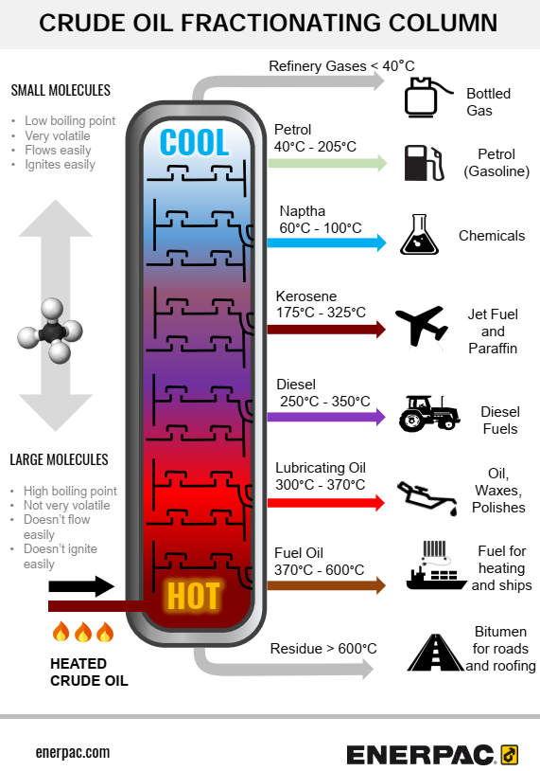

MOC | Mineral Oil Contaminants
MOH | Mineral Oil Hydrocarbons
MOSH | Mineral Oil Saturated Hydrocarbons: paraffin-like, commonly branched alkanes and cycloalkanes
MOAH | Mineral Oil Aromatic Hydrocarbons: highly alkylated mono- and poly-aromatic rings
MORE | Mineral Oil Refined Products: additives & processing aids with approved refined mineral oil products
POSH | Polyolefinic Oligomeric Saturated Hydrocarbons: from polyethylene (PE) and polypropylene (PP) plastic packaging
PAO | Poly Alpha Olefins: synthetic isoparaffins from lubricants and hot melt adhesives

Slide 3
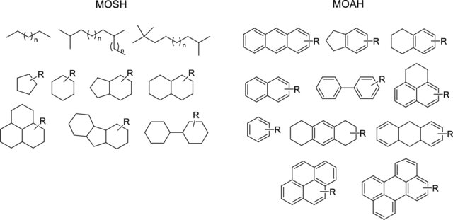
Number of isomers (including stereoisomers)
Decane C₁₀H₂₂: 75 (136)
Pentacontane C₅₀H₁₀₂: 1117743651746953270
(1.11437894744930×10²¹)
https://en.wikipedia.org/wiki/List_of_straight-chain_alkanes

Slide 4

EFSA Update of the risk assessment of MOH in food, 13 September 2023
It is likely to very likely (66-95% certain) that the present dietary exposure to MOSH does not raise concerns for human health.
It is extremely likely (99-100% certain) for toddlers and likely (more than 66% certain) for other age groups that present dietary exposure to 3- or more aromatic ring MOAH, which are associated with DNA damage and potentially causing cancer, raises a possible concern for human health.
Dietary exposure to 1-2 ring MOAH lacks reliable toxicity data, which might raise a concern.
MoE: Margin of Exposure of a substance is the ratio of its no-observed-adverse-effect level (NOAEL) to its theoretical, predicted, or estimated dose or concentration of human intake.
Substances that are neither genotoxic nor carcinogenic (MOSH): minimum of 100
Substances that are both genotoxic and carcinogenic (some MOAH): minimum of 10,000

Slide 5
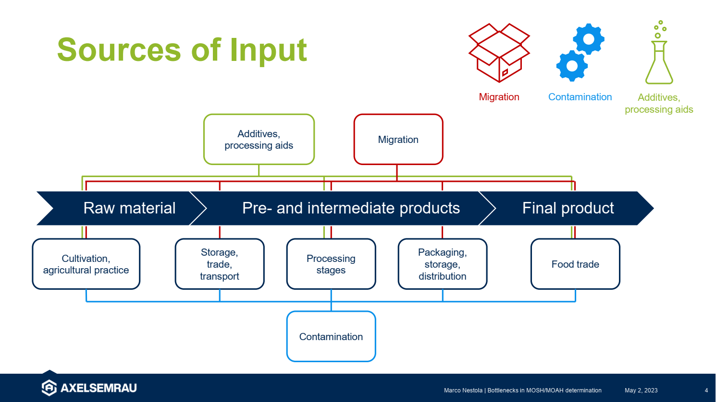

Slide 6
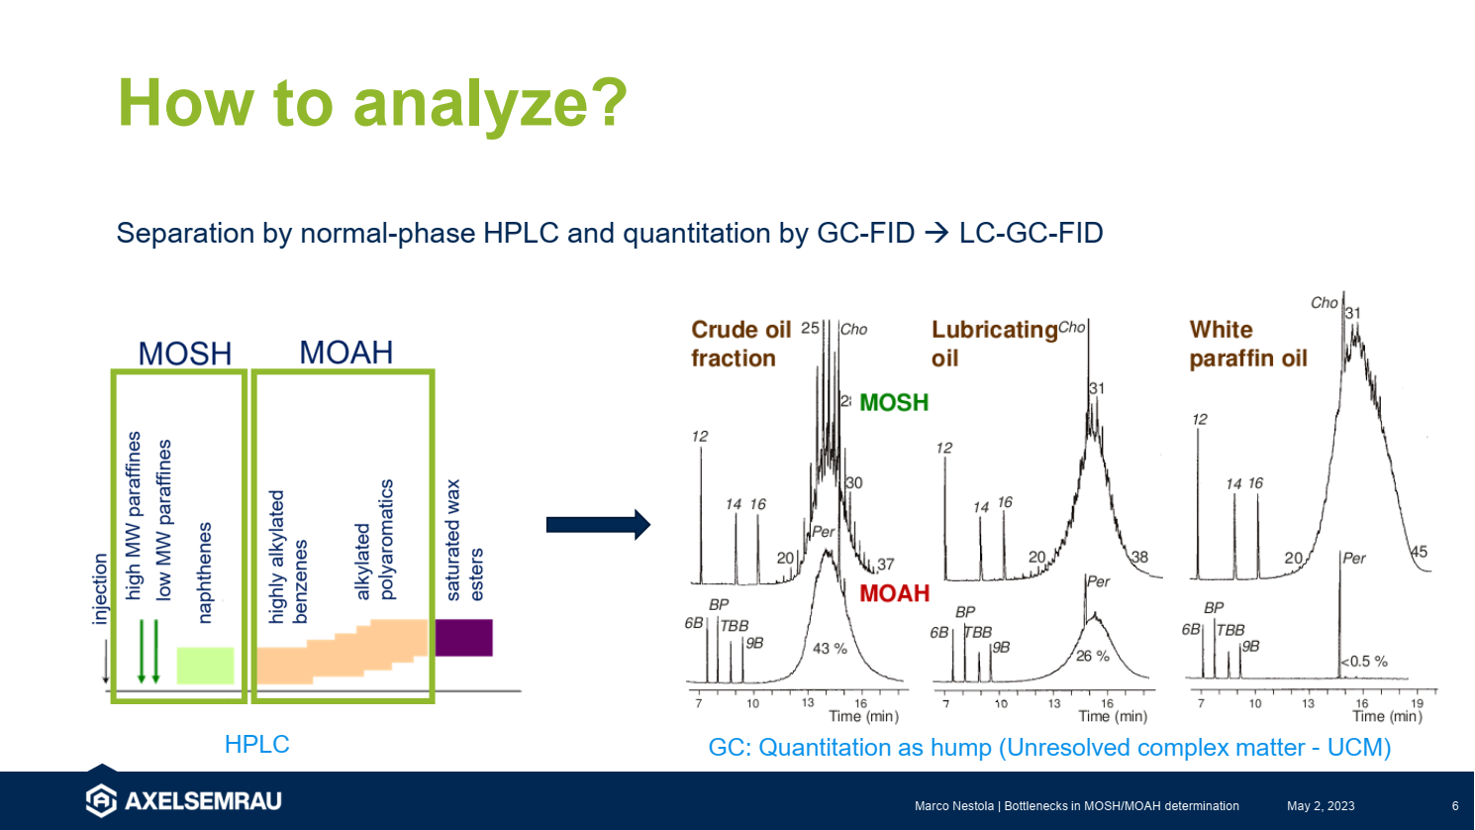


Slide 7
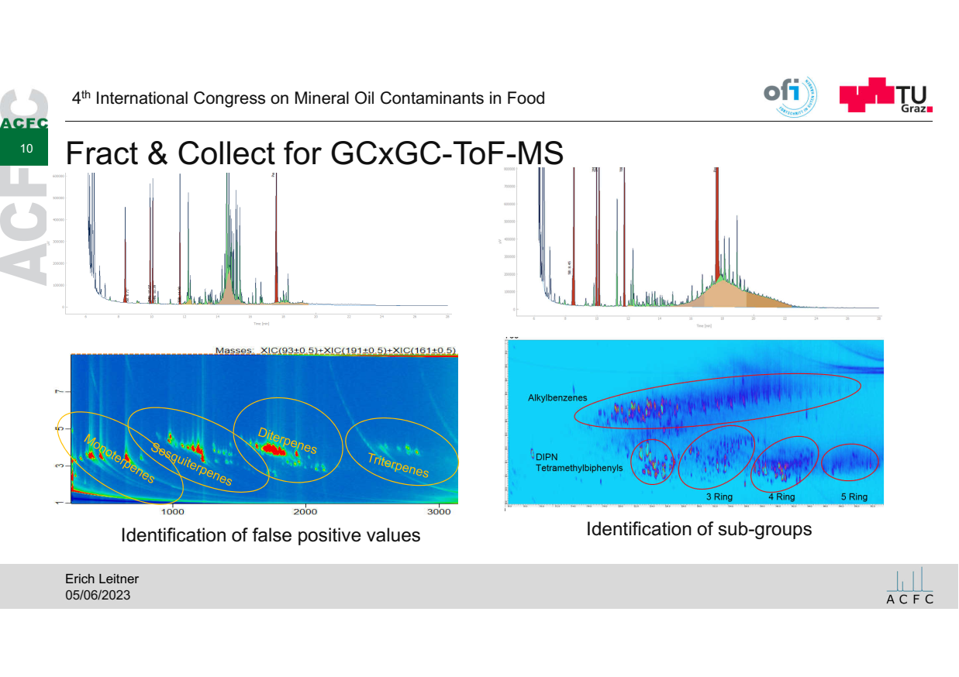

Slide 8
RASFF – Rapid Alert System for Food and Feed & HorizonScan
reference | date | subject | product | result | risk_decision | notifying_country
2025.3276 | 2025-05-02 | MOSH/MOAH in cinnamon powder | Cinnamon | 5.5 +/- 1.65 mg/kg | potentially serious | Luxembourg
2025.2986 | 2025-04-22 | MOAH in cinnamon powder | Cinnamon | 7.6 +/- 2.28 mg/kg | potentially serious | Luxembourg
2023.8465 | 2023-12-08 | Mercury and mineral oil hydrocarbons in ground cinnamon from Vietnam via the Netherlands and Spain | Cinnamon | 1.5 mg/kg | potentially serious | Germany
2023.8251 | 2023-11-29 | Mercury and mineral oil hydrocarbons in ground cinnamon, from Indonesia | Cinnamon | n/a | potentially serious | Germany
2023.1328 | 2023-02-23 | MOAH in cloves from Madagascar, via the Netherlands | Clove | 4.4 mg/kg | potentially serious | Belgium
2025.5736 | 2025-07-28 | MOAH in Cumin Powder from India | Cumin | 1.4 mg/kg | potentially serious | Netherlands
2025.3281 | 2025-05-02 | MOSH/MOAH in ground cumin from Germany, produced in Turkey | Cumin | 7.2 +/- 2.16 mg/kg | not serious | Luxembourg
2025.3280 | 2025-05-02 | MOSH/MOAH in organic ground cumin | Cumin | 2.5 +/- 0.75 mg/kg | potentially serious | Luxembourg
2025.3283 | 2025-05-02 | MOSH/MOAH in ground curcuma from Belgium | Curcuma (turmeric) | 6.7 +/- 2.01 mg/kg | potentially serious | Luxembourg
2025.3701 | 2025-05-19 | MOAH in Madras Curry Powder from India | Curry powder | 19 mg/kg | serious | Netherlands
2024.5601 | 2024-07-22 | Bacillus cereus and MOAH in Lemon Grass powder from Thailand | Lemon grass | 6.3 mg/kg | serious | Netherlands
2023.8886 | 2023-12-22 | Mineral oil components in ground pepper from Belgium | Pepper | 20.2 mg/kg | potential risk | Germany
2024.2707 | 2024-04-05 | MOAH and pesticide residues in Sichuan Pepper from China | Sichuan pepper | 7.7 mg/kg | serious | Netherlands
2024.3418 | 2024-04-29 | MOAH in vanilla bean from Papua New Guinea | Vanilla | 6.7 mg/kg | serious | Netherlands
2024.3103 | 2024-04-17 | Detection of mineral oil hydrocarbons in vanilla powder | Vanilla | 2.0 mg/kg | potential risk | France
2024.0755 | 2024-02-02 | MOAH (mineral oil aromatic hydrocarbons) in Vanilla powder from Madagascar | Vanilla | 2.8 mg/kg | serious | Netherlands

Slide 9
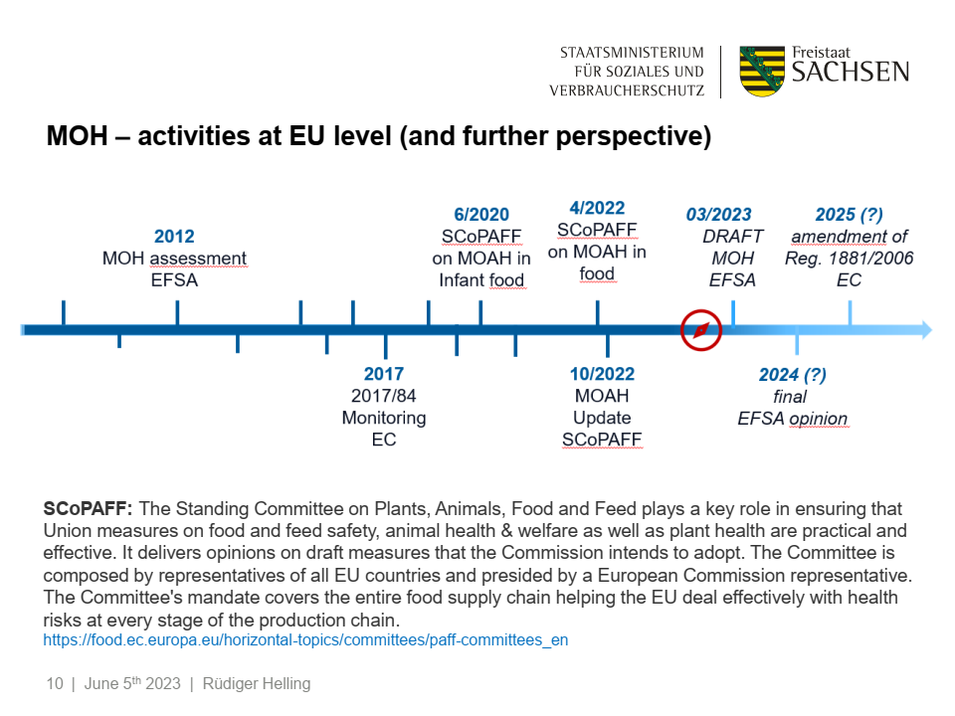

1 Jan 2027
Amendment of Reg. 2023/915 EC
13 Sep 2023

Slide 10
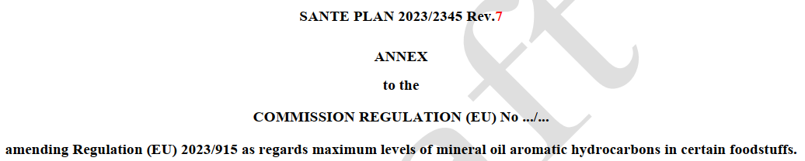
Effective 1 January 2027

Slide 11
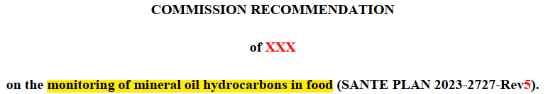
Monitor MOSH and MOAH in food during the years 2026 to 2029.
Monitoring of MOSH to include spices and dried herbs.
Monitoring of MOAH does not mention spices and dried herbs.
Validate methods for MOSH and MOAH in food based on comprehensive GCxGC.
Investigate causes of contamination when maximum levels for MOAH or indicative levels for MOSH or MOAH are exceeded. Includes indicative MOAH level for essential oils: 10 mg/kg. Indicative levels should not affect the possibility of placing products on the market.

Slide 12

The 5th International Congress on Mineral Oil Contaminants in Food is scheduled for September 30th - October 1st, 2025, in Berlin, Germany.
This event, organized by the German Society for Fat Science (DGF), will bring together scientists, regulators, and industry experts to discuss various aspects of mineral oil contaminants in food.
Key topics at the conference will include:
MOSH/MOAH analysis and advanced chromatographic techniques.
Regulatory developments.
Risk assessment and mitigation strategies.
Contamination sources and consumer safety.
https://veranstaltungen.gdch.de/microsite/index.cfm?l=11848&sp_id=2

